Slide 2
Litigating With Your Government Customer: When, Where and Why
PRESENTED BY Brad English, Nicholas Greer and Mary Ann Hanke
DATE December 1, 2021

Slide 3
How does the Government do business?
Largest buyer of goods and services in the world
Competition is mandated under Competition in Contracting Act; generally, must be full and open competition
  An executive agency in conducting a procurement for property or services shall – (1) obtain full and open competition through the use of competitive procedures in accordance with the requirements of this division and the Federal Acquisition Regulation. 41 U.S.C. § 3301(a)(1)
  Exceptions:
    Size and status set aside contracts
      Examples: Woman owned small businesses, service disabled veteran owned small businesses

Slide 4
Solicitations, Requests for Proposals and Requests for Quotes

Slide 5
What is a Solicitation/RFP/RFQ?
Necessary for government acquisition of goods or services
  Issued by procuring agency
Federal Acquisition Regulation (“FAR”) 48 C.F.R. § 2.101
  any request to submit offers or quotations to the Government. Solicitations under sealed bid procedures are called "invitations for bids." Solicitations under negotiated procedures are called "requests for proposals." Solicitations under simplified acquisition procedures may require submission of either a quotation or an offer.
Requests for Quotes (“RFQ”) differ from regular solicitations
  Response, or quotation, does not constitute an offer to the government – instead, government will take quotation and issue order to contractor based on quotation

Slide 6
Solicitation/RFP/RFQ
Section L
  Includes instructions, conditions and notices
  Provides information regarding how proposal should be drafted, including page limit, font specifications, and required volumes
  Also details how proposal should be submitted and when
    “Late is late” rule - Any proposal, modification, or revision, received at the Government office designated in the solicitation after the exact time specified for receipt of offers is “late” and will not be considered unless it is received before award is made, the Contracting Officer determines that accepting the late offer would not unduly delay the acquisition[.] 48 C.F.R. § 52.215-1

Slide 7
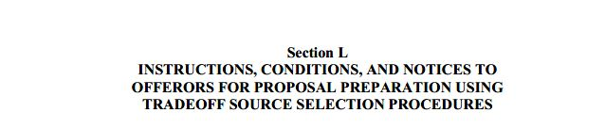
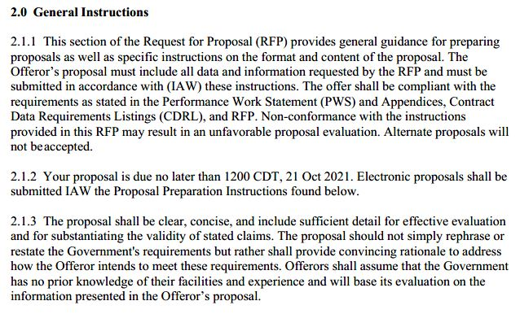
Solicitation/RFP/RFQ

Slide 8
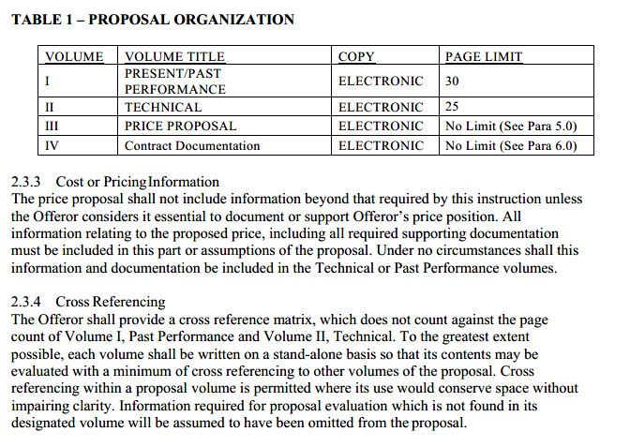
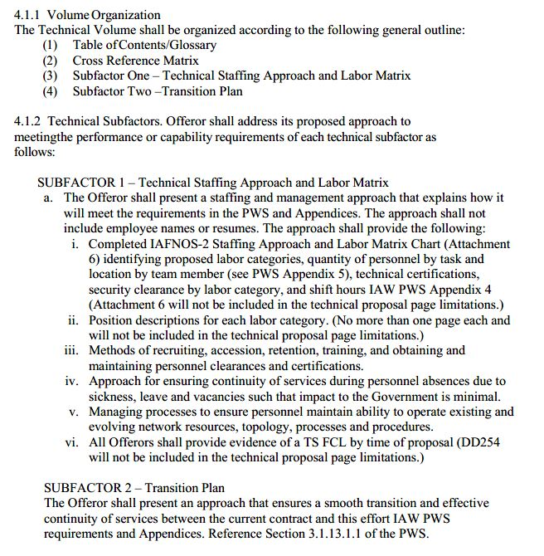
Solicitation/RFP/RFQ

Slide 9
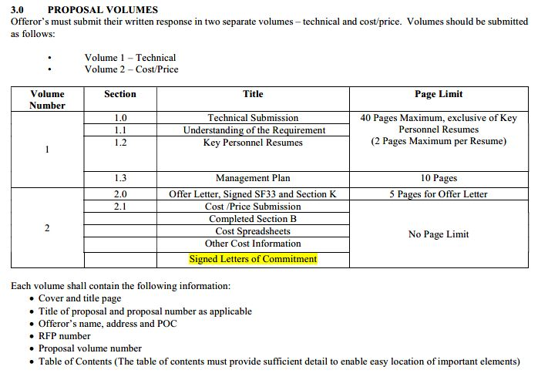
Solicitation/RFP/RFQ

Slide 10
Solicitation/RFP/RFQ
Section M
  Includes evaluation factors and criteria
  Usually includes definitions for adjectival ratings and confidence ratings

Slide 11

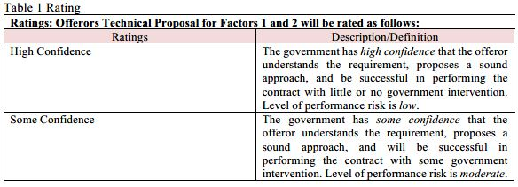

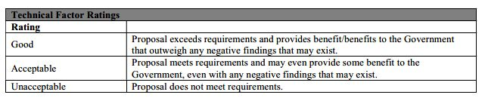
Solicitation/RFP/RFQ

Slide 12
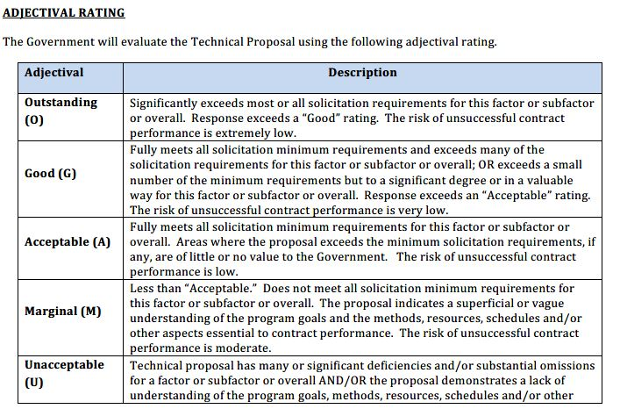
Solicitation/RFP/RFQ

Slide 13
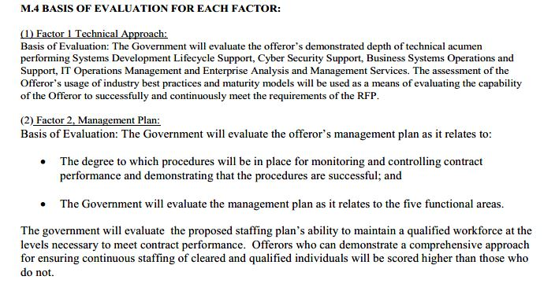
Solicitation/RFP/RFQ

Slide 14
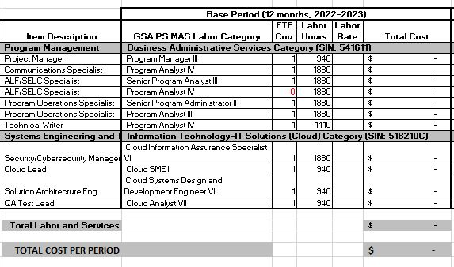
Solicitation/RFP/RFQ

Slide 15
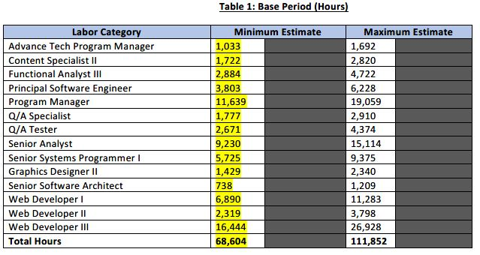
Solicitation/RFP/RFQ

Slide 16
Debriefing
The Agency must
  “[F]urnish the basis for the selection decision and contract award” and must include:
    “significant weak or deficient factors in offeror’s offer;”
    “overall evaluated cost and technical rating” of the awarded offer and protestor;
    “overall ranking of all offerors;”
    “summary of rationale for the award;”
    the make and model of item being accepted for award (for commercial item);
    “reasonable responses to relevant questions posed by the debriefed offeror” regarding agency’s source selection decision;
    and opportunity for offeror to submit additional questions within two days of receiving debriefing.
  41 U.S.C. § 3704(c) (Civilian); 10 U.S.C. § 3304(c) (DoD)
    Note: additional questions only allowed in enhanced debriefing provided during DoD procurement.

Slide 17
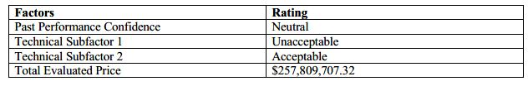
Debriefing

Slide 18
Bid Protests

Slide 19
What is a Bid Protest?
Competition in Contracting Act, 31 U.S.C. § 3551(1)
  A written objection by an interested party to any of the following:
      (A) A solicitation or other request by a Federal agency for offers for a contract for the procurement of property or services.
      (B) The cancellation of such a solicitation or other request.
      (C) An award or proposed award of such a contract.
Tucker Act, 28 USC § 1491(b)(1)
  Action by an interested party objecting to a solicitation by a Federal agency for bids or proposals for a proposed contract or to a proposed award or the award of a contract or any alleged violation of statute or regulation in connection with a procurement or a proposed procurement.

Slide 20
What is a Bid Protest?
Challenge to a government procurement
Pre-Award
  Challenge brought prior to government making award
  May be brought prior to solicitation’s due date (Blue and Gold)
    Necessary when challenging terms of solicitation, such as ambiguity
Post Award
  Challenge brought after government has made award
  Offeror challenges award to other offeror
Forum: Agency, Government Accountability Office (“GAO”) or Court of Federal Claims (“CoFC”)

Slide 21
What is a Bid Protest?
Federal Acquisition Streamlining Act of 1994 (“FASA”) bans protests on task orders
  41 U.S.C. § 4106(f) (Civilian); 10 U.S.C. § 3406(f) (DoD)
Task Order:
  A contract for services that (A) does not procure or specify a firm quantity of services (other than a minimum or maximum quantity); and (B) provides for the issuance of orders for the performance of tasks during the period of the contract. 41 U.S.C. § 4101(2); 10 U.S.C. § 3401(2).
Exceptions:
  $10 million for civilian agencies
  $25 million for DoD
  If FASA applies, GAO is the only option. If below jurisdictional thresholds, no protest.

Slide 22
Standing
Must be an “interested party”
  GAO: “[A]n actual or prospective bidder or offeror whose direct economic interest would be affected by the award of the contract or by failure to award the contract.” 31 U.S.C.A. § 3551(2)(A).
  CoFC: “[A]ctual or prospective bidders or offerors whose direct economic interest would be affected by the award of the contract or by failure to award the contract.” Rex Serv. Corp. v. United States, 448 F.3d 1305, 1307 (Fed. Cir. 2006)

Slide 23
Prejudice
Must be able to show Protestor had a “substantial chance” at receiving award but for Agency’s actions
  GAO: “Our Office will not sustain a protest unless the protester demonstrates a reasonable possibility that it was prejudiced by the agency's actions; that is, unless the protester demonstrates that, but for the agency's actions, it would have had a substantial chance of receiving award.” Chardonnay Dialysis, LLC, B-420910 (Oct. 27, 2022).
  CoFC: Protestor must be able to show the Agency’s actions prejudiced it and that, but for the Agency’s conduct, protestor would have had a “substantial chance” at receiving award. Bannum, Inc. v. United States, 404 F.3d 1346, 1353 (Fed. Cir. 2005).

Slide 24
Agency Level Protests
Protest lodged directly with Contracting Officer
  Provides government chance to fix issues in a litigation posture, preserves challenges; stays procurement
  Least likely to get relief
Contracting Officer must suspend performance if protest is raised within:
  10 days after award or
  5 days from Agency’s debriefing
  Can avoid suspension if Agency deems urgent and compelling needs
Must include detailed statement of legal and factual grounds of protest and requested relief
Can appeal decision to either GAO or Court of Federal Claims, subject to FASA bar

Slide 25
GAO
GAO must issue decision within 100 days of protest filing
Standard of Review
  GAO “examines the record to determine whether the agency's judgment was reasonable, and in accordance with solicitation criteria and applicable procurement statutes and regulations.” Patriot Def. Grp., LLC, B-418720.3, 2020 CPD P 265 (Aug. 5, 2020).
CICA stay applies if protest is filed within 10 days from date of award, or when basis of protest is known or should have been known; 5 days from required debriefing
Protest must include detailed statement of legal and factual grounds for protest
  Letter format
  Agency must file Agency Report within 30 days of receiving notice of protest from GAO
    5 day Letter → Agency Report will include proposals, evaluation documents, contracting officer statement and memorandum of law
  Parties have 10 days to file Comments on Agency Report

Slide 26
Court of Federal Claims
Protest must be filed either prior to deadline to submit offers (Pre-Award) or any time after award is made (Post-Award)
Pre-Award Timeliness:
  “[A] party who has the opportunity to object to the terms of a government solicitation containing a patent error and fails to do so prior to the close of the bidding process waives its ability to raise the same objection subsequently in a bid protest action in the Court of Federal Claims.” Blue & Gold Fleet, L.P. v. United States, 492 F.3d 1308, 1313 (Fed. Cir. 2007)
  The Federal Circuit has held that a timely Agency protest regarding language of a solicitation preserves the action Harmonia Holdings Group, LLC. v. United States, 20 F.4th 759 (Fed. Cir. 2021.) The Federal Circuit has further held that the government’s awareness of a potential legal or regulatory violation qualifies as a challenge to the procurement for standing purposes. SEKRI, Inc. v. United States, 34 F.4th 1063, 1073 (Fed. Cir. 2022)

Slide 27
Court of Federal Claims
There is no deadline to file Post-Award Bid Protest
  There is also no stay of performance → must file Motion for Preliminary Injunction to prevent performance during pendency of protest
Protestor files normal complaint that adheres to Twombly/Iqbal pleading standards; the Rules of the Court of Federal Claims largely track the Federal Rules of Civil Procedure
Government files Administrative Record
  Includes solicitation documents, subject proposals, evaluation documents
Protester will then file Motion for Judgment on Administrative Record (RCFC 52.1)
  Defendant (Government) and Intervenor (Awardee) will file Cross Motions for Judgment on Administrative Record
Parties will then have oral argument

Slide 28
Court of Federal Claims
Court uses CM/ECF, majority of filings are under seal to protect confidential/proprietary information
Standard of Review
  “[A] reviewing court shall set aside the agency action if it is ‘arbitrary, capricious, an abuse of discretion, or otherwise not in accordance with law.” Banknote Corp. of Am. v. United States, 365 F.3d 1345, 1350-51 (Fed. Cir. 2004).
  “[A] procurement decision may be set aside if it lacked a rational basis or if the agency's decision-making involved a clear and prejudicial violation of statute, regulation or procedure.” Chenega Healthcare Services, LLC v. United States, 141 Fed. Cl. 254 (2019)
Court of Appeals for Federal Circuit has jurisdiction over appeals
  Reviews CoFC decisions de novo using same standard of review
  Factual findings are reviewed for clear error

Slide 29
Claims

Slide 30
Claims
Differ from protests – claims are disputes that arise after contract award and occur between a contractor and the government
Jurisdiction
  Tucker Act – must be brought in Court of Federal Claims
    The United States Court of Federal Claims shall have jurisdiction to render judgment upon any claim against the United States founded either upon the Constitution. . .or upon any express or implied contract with the United States[.] 28 U.S.C.A. § 1491(a)(1)
Breach of contract claim – governed by Contract Disputes Act
  41 U.S.C. § 7102(a)

Slide 31
Claims
Most government contracts contain a standard disputes clause – 48 C.F.R. 53.233-1
  Claim, as used in this clause, means a written demand or written assertion by one of the contracting parties seeking, as a matter of right, the payment of money in a sum certain, the adjustment or interpretation of contract terms, or other relief arising under or relating to this contract.
    48 C.F.R. 53.233-1(c)
This clause is incorporated into contracts and directs contractors to 41 U.S.C. Chapter 71 for claims and dispute procedures

Slide 32
Claims
Contract changes
Breach of contract
Past performance
Terminations
Defective specifications

Slide 33
Claims
Contract Changes
  Authority to Change
  Methods
    Unilateral
    Bilateral
  Analyzing change
    Is additional work required?
    Is additional work in or outside scope of contract?
      In scope – changes clause
      Out of scope – justification & approval or issue new contract
    Effect of change?
      Will change increase time or money contractor must spend to perform
    Constructive change?

Slide 34
Claims
Elements of changes
  Government action/inaction caused the change
  Contractor did not perform voluntarily
  Increase in cost or time of performance
  Order Theory/Fault Theory
CO must be notified and can adopt, reject and disclaim, or adopt the conduct but deny the change exists

Slide 35
Claims
Request for Equitable Adjustment (“REA”)
  Contractor officially asking Agency to adjust contract price to include additional costs based on change in contract requirements
  Attempt to work out with CO first
  REA is viewed as less adversarial, however delays timeline if denied

Slide 36
Claims
Submitting a claim – 41 U.S.C. § 7103
Written demand
    Must be sent to CO first and must seek final decision
    Elements of proper claim, sought as a matter of right
      Sum certain
      Adjustment or interpretation of contract terms
      Other relief
      Submitted to CO for final decision
        Must be certified if claim is over $100k
    Must be decided within 60 days
      Government can extend deadline to respond, usually once and no more than 60 days; can result in deemed denial
    Final decision can be appealed to two forums
  Ensure written demand includes ALL claims and requested relief

Slide 37
Litigating Claims
Boards of Contract Appeals
  Civilian Board of Contract Appeals (CBCA)
  Armed Services Board of Contract Appeals (ASBCA)
Appeal must be brought within 90 days of final decision by CO
  Streamlined proceedings, limited discovery
  Government represented by Agency counsel
  Presumptive trial location where contractor resides
  Presume that “entitlement” and “quantum” are tried separately
  Very consistent, rigidly applied precedent
    Look to file here if law favors your side on claim
  Standard of Review - 41 U.S.C. § 7104
Can appeal decision to Court of Appeals for Federal Circuit

Slide 38
Litigating Claims
Court of Federal Claims
  Must be brought within 12 months of final decision
  Proceeds like standard federal court case
  Government represented by DOJ’s Commercial Litigation Branch, National Courts Section
  Presumptive trial location likely in DC at National Courts Building, travel will be necessary
  Presumption that entitlement and quantum are tried together
  Precedent is non-binding; factions among judges
  Can be more equitable
Appeals brought to Court of Appeals for Federal Circuit

Slide 39
Litigating Claims
Damages
  Special rules about damages – use an expert!
    Actual Cost – Specific costs, segregate and allocate – most favored
    Total Cost – Jury verdict method – strongly disfavored
    Modified Total Cost – Can be accepted in some instances

Slide 40
Questions?

Slide 41
Contact Info
Brad English – BEnglish@maynardcooper.com
Nicholas Greer – NGreer@maynardcooper.com
Mary Ann Hanke – MHanke@maynardcooper.com

Slide 42

maynardcooper.com

