Slide 1
Involuntary Commitments

Slide 2
Old Bryce Hospital

Slide 3
Replacement Mental Health Hospital, Tuscaloosa, Al.

Slide 4
Grounds for Placement:
Commitment on grounds person is mentally ill and as a consequence of such mental illness poses a real and present threat of substantial harm to himself or to others
§ 22‑52‑10.4. Permissible only in those situations in which threatened or actual harm is of a nature which the state may legitimately control, specifically if there is a "serious threat of substantial harm to himself or others". Lynch v. Baxley, 386 F. Supp. 378, (M.D. Ala. 1974), rev'd. on other grounds, 651 F.2d 387 (5th Cir. 1981). Lynch v. Baxley, 744 F.2d 1452 (11th Cir. Ala. 1984).

Slide 5
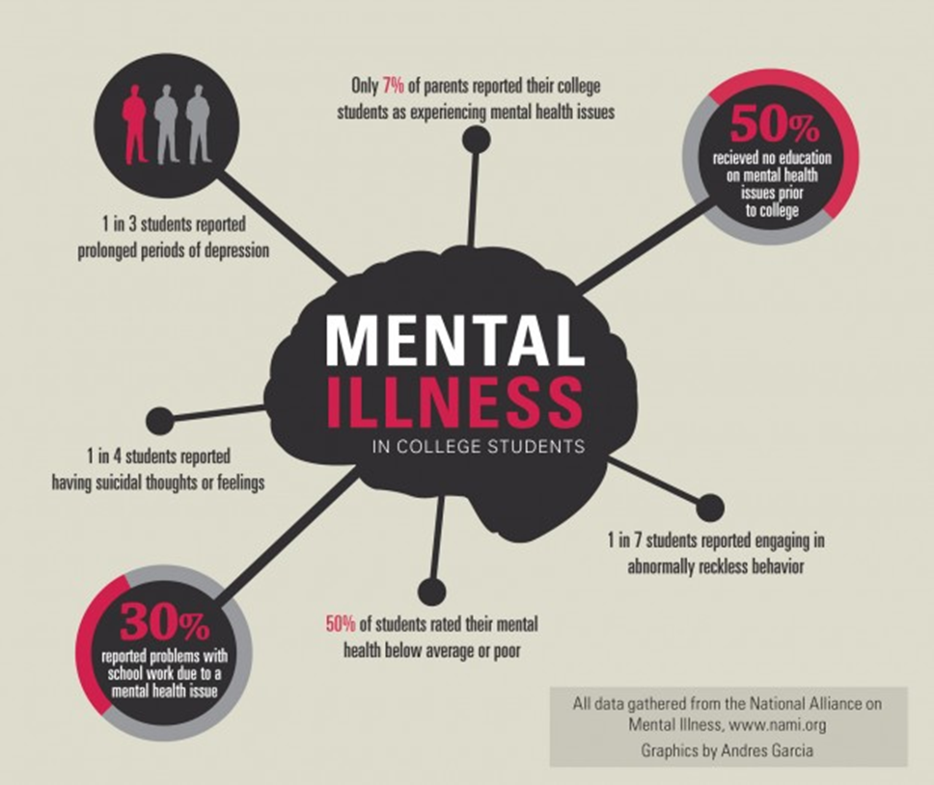

Slide 6
CRITERIA FOR COMMITMENT: § 22-52-10.4
PERSON IS mentally ill; and
As a consequence the person poses a real and present threat of substantial harm to himself or others; and
If not treated, respondent's mental illness will continue to deteriorate and
Respondent cannot make a rational decision regarding necessity of treatment.
No treatment presently available but confinement is necessary to prevent harm. See In re Wilson, 431 So. 2d 552 (Ala. Civ. App. 1983) mental illness manifests itself in neglect or refusal to care for himself, which poses a real and present threat of substantial harm to his wellbeing, and that he is incompetent to determine for himself whether treatment would be desirable.
Probate Judge need not find recent over act to involuntarily commit mentally ill patient to inpatient treatment. Garrett v. State, 707 So.2d 273, Ala. Civ. App. 1997.

Slide 8
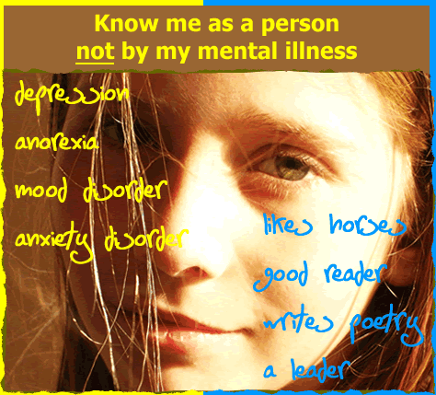

Slide 9
MENTAL ILLNESS DIAGNOSIS Kinds of Mental Illnesses:
a. Neurosis ‑ mild emotional disorder which reduces a person's ability to live happily, but does not lose a sense of reality, moody.
b. Personality disorder ‑ character traits which make it difficult to get along with others. Often alcohol or drug addict, self-centered.
c. Manic depressive psychosis ‑ mania (elation) depression (blueness), t reatable with "Lithium carbonate".
d. Schizophrenia ‑ thought disorder - often paranoid, withdrawn, out of touch with reality.
e. Paranoia ‑ excessive concern that others are out-to-get an individual.
f. Alzheimer's ‑ graduating deterioration of all mental facilities.
g. Excluded from the definition of mental illness is the primary diagnosis of epilepsy, mental retardation, substance abuse, alcoholism or developmental disability.
§ 22-52-1.1

Slide 10
Procedure\ Sample forms
Court: § 22‑52‑1.2 Probate Court
Probate Judge Jurisdiction: § 22‑52‑11 County where the person is located.
C. Place of Commitment: § 22-52-7 Department of Mental Health or other public facility .
D Petition: § 22‑52‑1.2
.
E. Review of Petition: § 22‑52‑2
F. Notice to Person to Be Committed § 22‑52‑3

Slide 11
Guardian Ad Litem: § 22‑52‑4
Attorney for Respondent: § 22-52-4
I. Temporary Commitment: § 22‑52‑7
Conduct of Hearings: § 22-52-9.
Costs: § 22‑52‑14
L. Facilities for Treatment: § 22-52-10.5
M. Temporary Custody Of Alleged Mentally Ill: § 22-52-91

Slide 12
Conveyance of Person to Facility: § 22-52-12
Appeals: § 22‑52‑15
P. Length of Treatment §22-52-10.5

Slide 13
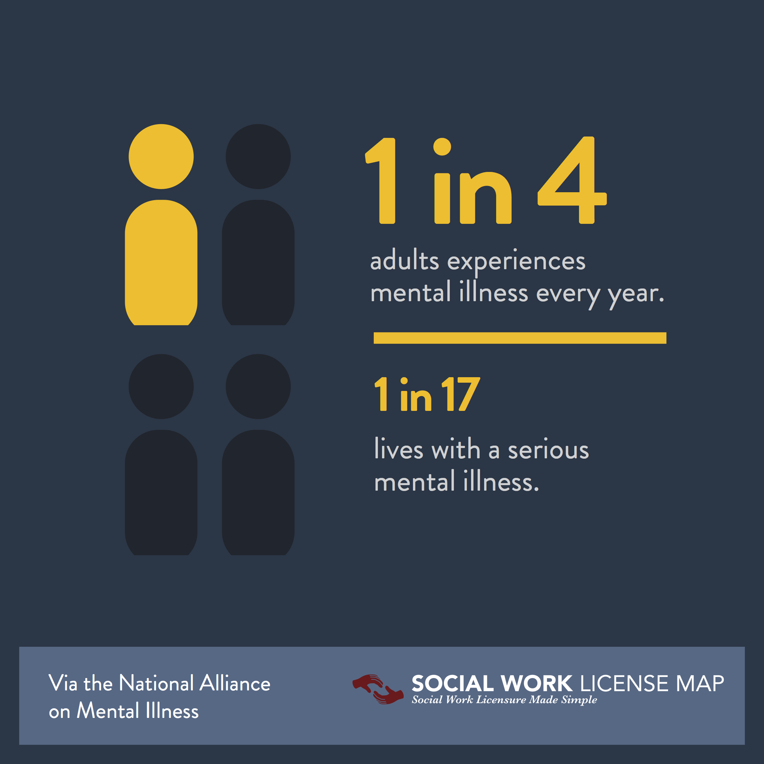

Slide 14
By the numbers: Mental illness behind bars
The statistics paint a stark picture, with mental illness affecting a greater percentage of jailed women than men:
In state prisons, 73 percent of women and 55 of men have at least one mental health problem
In federal prisons, 61 percent of women and 44 percent of men
In local jails, 75 percent of women and 63 percent of men
Federal trial begins on mental health care in Alabama prisons

Slide 15
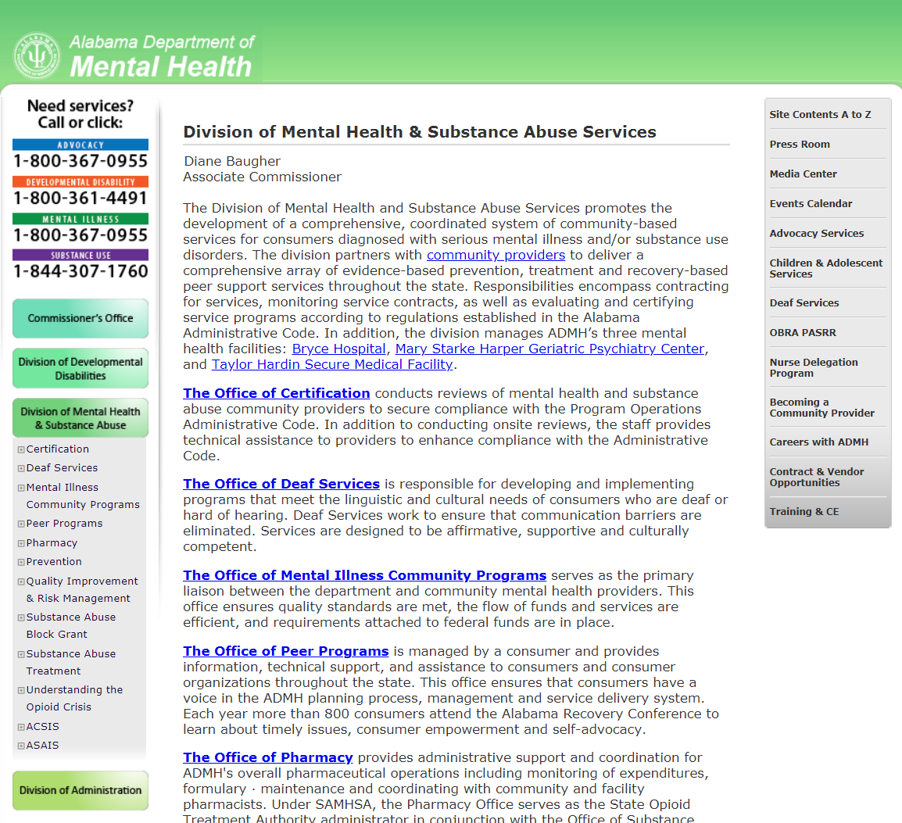

Slide 16
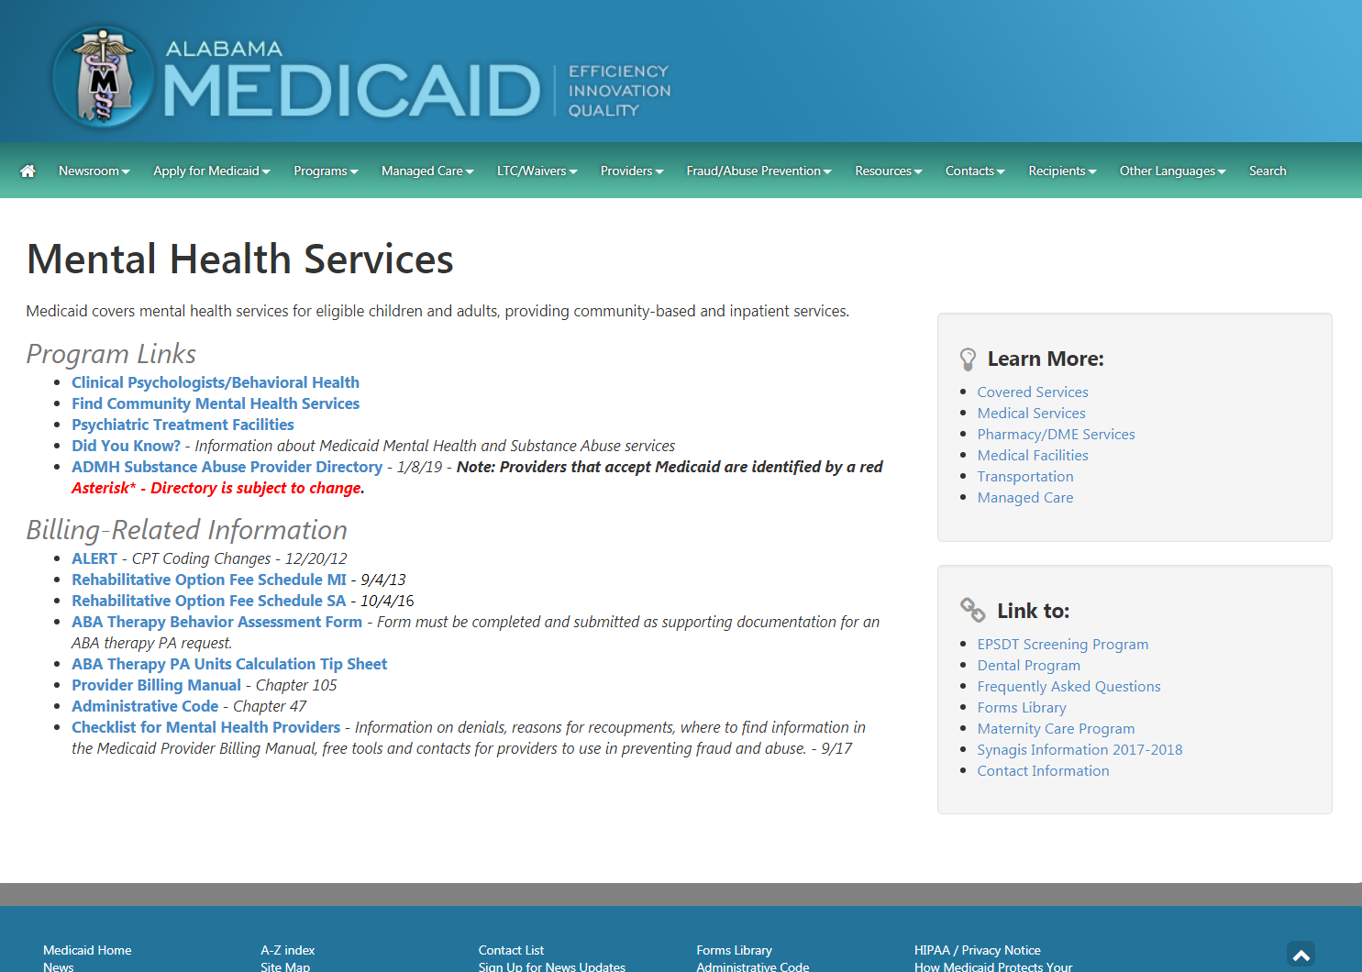

Slide 17
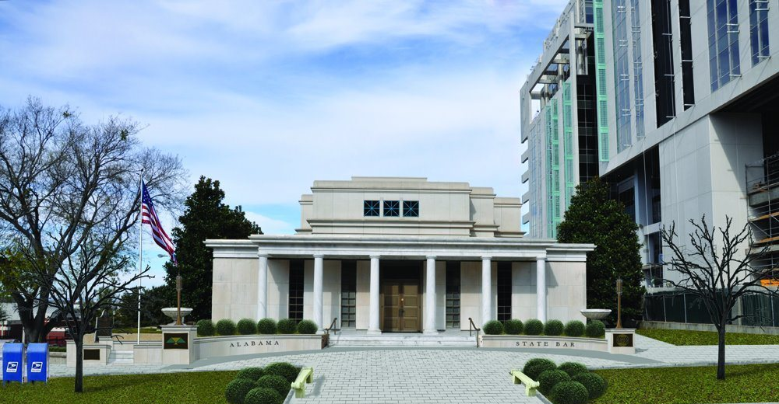
Solo and Small Firm Section of the Alabama Bar.

