Slide 1
APPLICATIONS OF CHATGPT IN YOUR LAW PRACTICE
BY ERIC ARTRIP and NAOMI Adkins

Slide 2
OVERVIEW
What is ChatGPT?
The Confidentiality Problem
ChatGPT is Not a Legal Research Tool
Applications – Custom Instructions
Applications – Prompt Engineering
Applications – Live Demonstration
Q&A

Slide 3
WHAT IS CHATGPT?
ChatGPT is an AI-driven program that simulates conversation with users, offering text-based responses.
Generative: Creates coherent and contextually relevant responses.
Pre-trained: Utilizes databases of text across the internet.
Transformer: Understands context.
ChatGPT 3.5 vs. 4.
Notes:
First debut in November of 2022. Generative, self-explanatory. Pretrained on three categories: 1. Internet 2. Third party applications (mostly for integration) 3. User training data .This allows ChatGTP it to 'transform' simple inputs into more nuanced, human-like responses. Think of it like an advanced autocomplete like the iphone. Explain differences between the free and paid model.

Slide 4
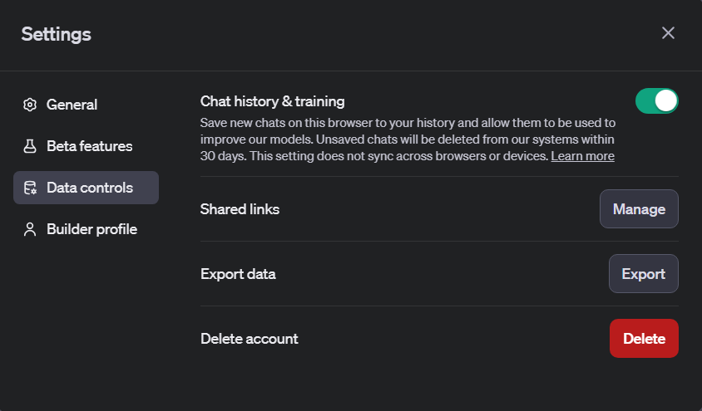
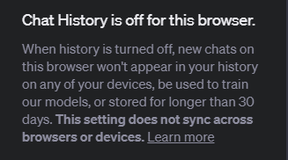
THE CONFIDENTIALITY PROBLEM
How to ensure client confidentiality is not compromised when using ChatGPT:
1. Removing identifying information.
2. Disable chat history and training.
Notes:
ABA Rule 1.6 Confidentiality of Information - Comment
[4] Paragraph (a) prohibits a lawyer from revealing information relating to the representation of a client. This prohibition also applies to disclosures by a lawyer that do not in themselves reveal protected information but could reasonably lead to the discovery of such information by a third person. A lawyer's use of a hypothetical to discuss issues relating to the representation is permissible so long as there is no reasonable likelihood that the listener will be able to ascertain the identity of the client or the situation involved.

Slide 5
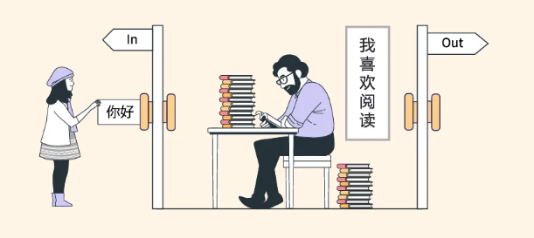
ChatGPT is Not a Legal Research Tool
Two lawyers and their New York-based law firm were fined for submitting fictitious legal cases in an aviation injury generated by ChatGPT.
Predictive text mechanisms based on internet data can lead to hallucinations.
Notes:
Explain Chinese room thought experiment. How does this happen? ChatGTP can generate plausible but factually incorrect or non-existent information.
AI tools should complement, not replace, diligent legal research and verification processes.
Critical for lawyers to independently verify AI-generated information, especially in formal legal settings.

Slide 6
ChatGPT is Not a Legal Research Tool
Examples of hallucinations:
Notes:
This slide was generated by asking ChatGTP to generate some cases along these lines in Madison County. These are fake cases.

Slide 7
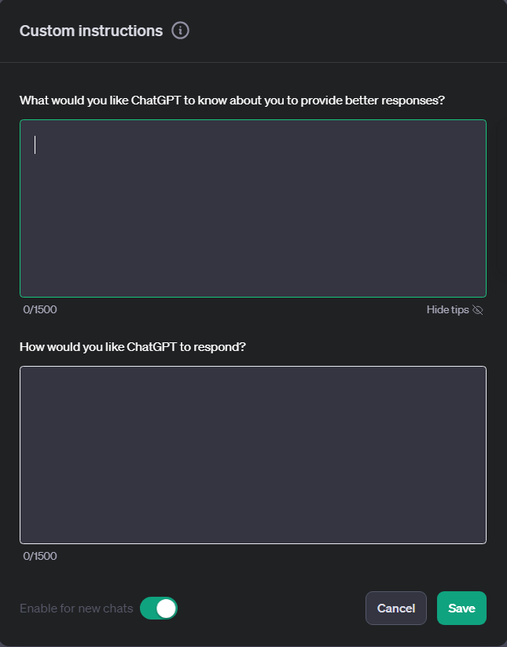
Applications – custom instructions
Specify the kind of work ChatGPT will be assisting you with.
Notes:
Here, you can specify your practice areas, the tone you would like it to take. For example, I would put that I am a paralegal from a civil firm etc.

Slide 8
Applications – prompt engineering
Prompt engineering is the process of crafting specific and detailed instructions to guide AI in generating useful and accurate content.
Use clear and unambiguous language in your prompts.
Example: Instead of ‘Draft a Complaint,' use 'Draft a complaint with the following information [insert case facts, desired counts, etc.] Include all necessary details like parties involved, legal issues, and specific terms.
Notes:
ChatGTP is iterative: If the first draft or response is lacking, follow up with your requested changes.

Slide 9
APPLICATIONS – DEMONSTRATION
General and Case Specific Legal Questions
General Correspondence
Damages Calculations
Demand Letters
Deposition Outlines
Complaints and Motions
Proofing and Revising
Document Analysis
Notes:
Live Demonstration of ChatGTP, see LIVE DEMONSTRATION TEST DOCUMENT.

Slide 10
QUESTIONS?

Slide 11
Sources
Schade, M. (2023) How CHATGPT and our language models are developed: Openai help center, How ChatGPT and Our Language Models Are Developed | OpenAI Help Center. Available at: https://help.openai.com/en/articles/7842364-how-chatgpt-and-our-language-models-are-developed (Accessed: 26 November 2023).
Perlman, A. (2023) The implications of CHATGPT for Legal Services and society, Harvard Law School Center on the Legal Profession. Available at: https://clp.law.harvard.edu/knowledge-hub/magazine/issues/generative-ai-in-the-legal-profession/the-implications-of-chatgpt-for-legal-services-and-society/ (Accessed: 26 November 2023).
Milmo , D. (2023) Two US lawyers fined for submitting fake court citations from chatgpt, The Guardian. Available at: https://www.theguardian.com/technology/2023/jun/23/two-us-lawyers-fined-submitting-fake-court-citations-chatgpt (Accessed: 26 November 2023).

