Slide 1
What is intellectual property?
Copyrights
IP refers
to legally
protected
creations of the
human intellect.
Patents
Trademarks
Trade Secrets
Notes:
Intellectual Property = IP = Idea Protection
Every business represented here, whether it has been around for years or is just an idea, has intellectual property. But before IP can be protected, we have to be able to identify it.
Originates from U. S. Constitution – “To Promote the Progress of Science and useful Arts…”

Slide 2
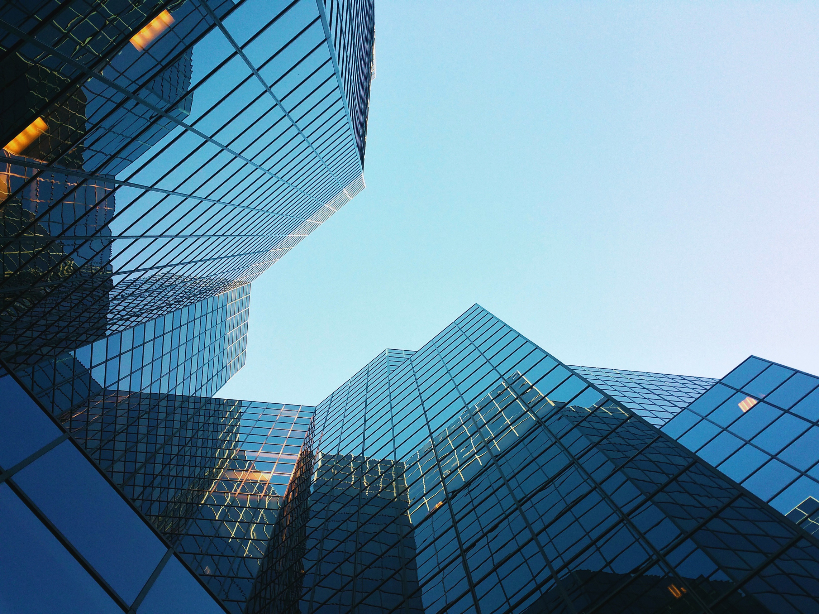
What are copyrights?
Books
They are the exclusive rights given to an originator to use and distribute a creative work such as a book, photography, article, song, or a film usually for a limited amount of time.
Photography
Movies
Songs
Notes:
Subject Matter:
Works
of original authorship
Fixed
in a tangible medium of expression
from which they can be perceived, reproduced, or otherwise communicated
directly, or with the aid of a machine or device
Works of authorship include:
Literary works
Musical
Dramatic
Pantomime
Pictorial, graphic, sculptural
Motion pictures, other audiovisual
Sound recordings
Architectural works
Copyright holder owns the EXCLUSIVE right (bundle of sticks/rights):
to reproduce
to prepare derivative works
to distribute copies
to publicly perform
to publicly display
Copyright Law will not protect:
Ideas
Procedures
Processes
Systems
Methods of operation
Concepts
Principles
Discoveries

Slide 3
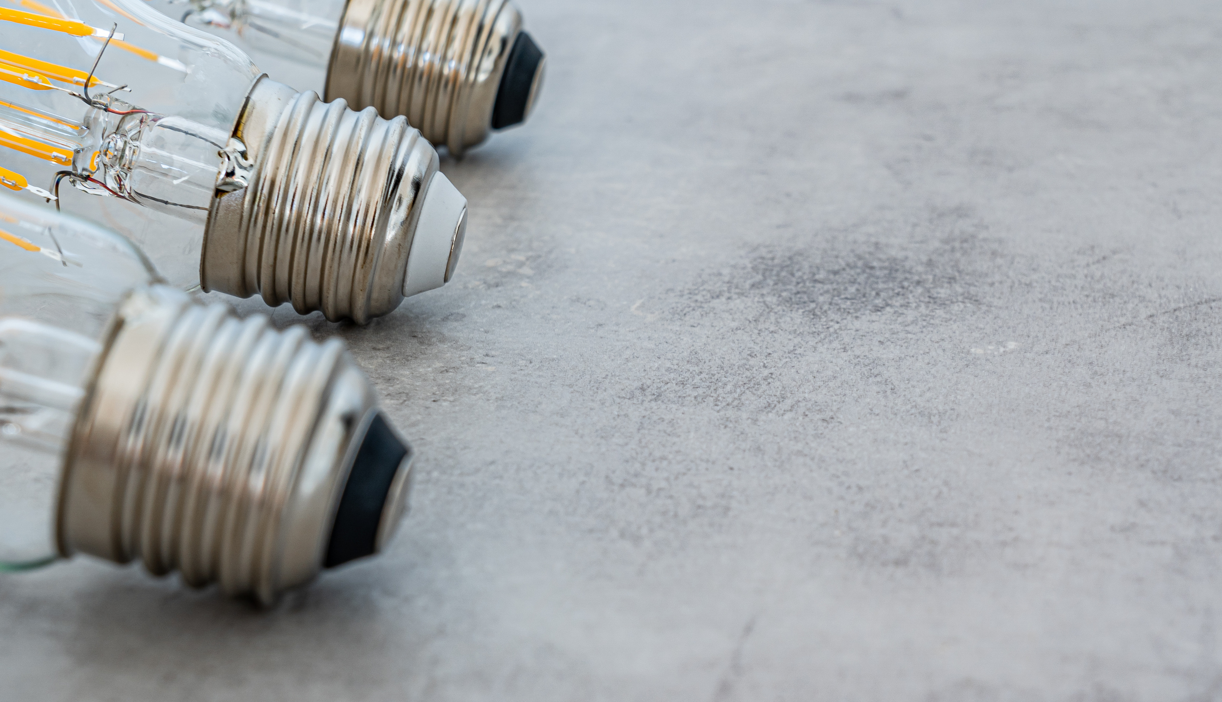
Copyright
Subject Matter:
Works
of original authorship
Fixed
in a tangible medium of expression
from which they can be perceived, reproduced, or otherwise communicated
directly, or with the aid of a machine or device

Slide 4
Copyright
Works of authorship include:
Literary works
Musical
Dramatic
Pantomimes
Pictorial, graphic, sculptural
Motion pictures, other audiovisual
Sound recordings
Architectural works

Slide 5
Copyright
Term of protection:
“rights” vest at moment of authorship/creation
Copyright Registration not required for vesting of rights
Registration IS required for enforcement of rights
for individual author - life, plus 70 years
for corporation - lesser of:
95 years from publication, or
120 years from creation

Slide 6
Copyright
Copyright – Non-employee as Author
Employee authorship – in line and scope
“Author” is the employer
Employer owns the copyright rights
Independent contractor author
Ind. contractor owns the copyright rights
unless otherwise agreed in writing
Notice provision
“Copyright 2023 Loftin Holt LLP”

Slide 7
Copyright
Typical Copyright Matters
Registrations of all types of authorship
Artwork
Photography
Software
Joint works
Derivative works
Licensing of Works
Assignments – by commissioned authors to the payor
Architectural works
Maps
Music

Slide 8
Word of caution:
Just because you find a picture on the internet, that does not mean you have the right to use it.
I know of multiple attorneys who have been the target of copyright enforcement actions for using images that they found online on their firm website. There are sites available that provide freely licensed images. But, if you simply clip a photo or image from another site (e.g., of the Huntsville skyline), and use that photo on your website, you may be infringing someone else’s copyright. You don’t have to know who the author and owner of the copyright is to infringe…it’s enough to know that YOU are NOT the author/owner.

Slide 9
New Machinery
What are patents?
They are legal documents for processes, plants, machines, or designs that give you the right to protect your intellectual property by excluding others from marketing, selling, or using your property for 20 years.
Processes
Chemicals
Plants
Notes:
Patents do not give you the right to do anything. They give the patent owner a right to exclude others from taking certain actions. In some cases, a patent owner may need a license from another patent owner if the second party’s patent is essential to practice the first party’s patented invention. For example, an inventor may be able to patent an improvement on another party’s product, even if that product is already patented. But, the inventor of the improvement may have to obtain a license from the owner of the original product in order to practice the improvement.
What is patentable? “Any new or useful process, machine, manufacture, or composition of matter, or any new and useful improvement therefor”; i.e., new, useful, and nonobvious
What is not patentable? Laws of Nature, Natural Phenomena, Purely Mathematical Algorithms
If possible, file before disclosure. Public disclosure/offer for sale may bar future efforts to patent.

Slide 10
Government-granted Monopoly
20 years from date of filing for currently issued patents.
17 years for patents issued before June 8, 1995.

Slide 11
What Are Parts of Application?
Abstract
Specification
Field of invention
Background (problems solved).
Summary
Detailed description
Drawings
Claims (defines scope of monopoly)

Slide 12
Design Patents
For ornamental features
Important, unique, and worthy of separate protection
Examples:
Furniture
Jewelry
Christmas ornaments
Does not cover function

Slide 13
What are trademarks?
Words
They are any word, phrase, symbol, design, or a combination of these things that identifies your goods or services. It helps consumers choose goods easily based on the reputation and quality.
Phrases
Symbols
Designs
Notes:
Even sounds and smells

Slide 14
Trademarks
Important IP right
Identifies brand for consumers
Relatively inexpensive to protect
Opportunities for foreign protection
Long-term protection while in use (Oldest registered mark still in use registered in 1884)
Provide value for expansion beyond core business
May be assigned, pledged, licensed
Registration is important

Slide 15
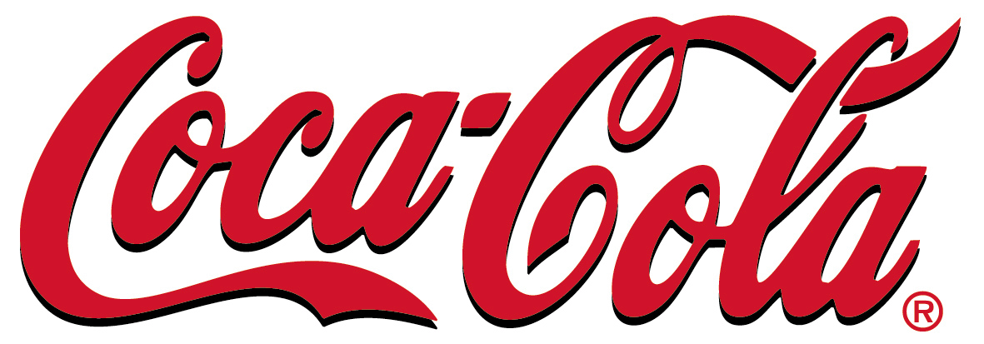
Trademarks
Indicates source of goods and services
Word, name, symbol, device, sound, color
Used to distinguish your goods and services from those sold by others
Brand identity
NBC peacock, and chimes
Logo and trade dress
Color green for farm equip.
Nike “swoosh”

Slide 16
Trademarks
Trademarks – Weak to Strong
Generic words – pizza, shoe
Descriptive – describe a feature of the goods
Suggestive – requires mental connection
Arbitrary – use word with different meaning
Coined, Fanciful – totally made up

Slide 17
Trademarks – Weak
Generic - common names not capable of exclusive ownership (pizza, house, automobile)
Descriptive - describe a characteristic, element, function, of the product; very weak, but inexpensive to put in use
Not protectable till acquire "secondary meaning" in consumer's mind. “So associated with the product that it identifies the source of the product and distinguishes the product from those of others”. Jeld-Wen v. Dalco Industries (8th Cir. 11/10/99)

Slide 18
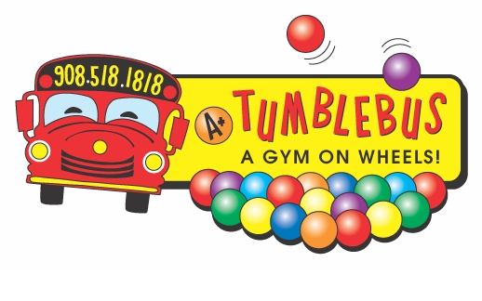
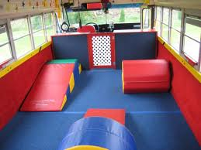
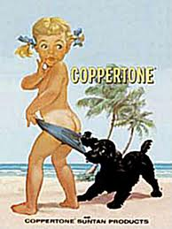
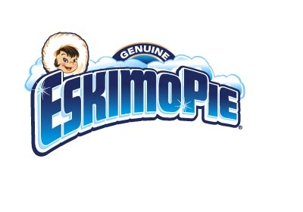
Trademarks – Strong
Suggestive - suggest something about the product, but do not describe it
Requires imagination, thought, and perception

Slide 19
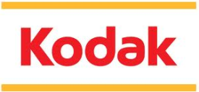
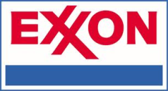
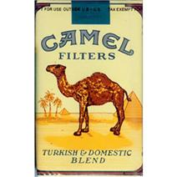
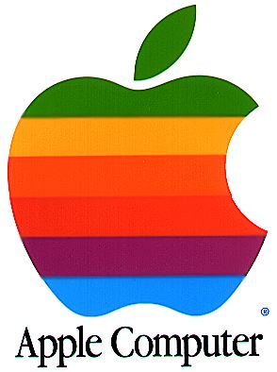
Trademarks – Strongest
Fanciful or "coined" – meaningless
Arbitrary
well-known words - arbitrary use

Slide 20
Trademarks
Infringement: Likelihood of confusion as to source or sponsorship between two marks
Many factor test
Similarity of marks
Similarity of goods / services
Strength of mark
Similarity of channels of trade
Sophistication of purchasers (Lexus vs Lexis)

Slide 21
“Dead” Marks – Failure to Police
Escalator
Trampoline
Cube steak
High octane
Raisin bran
Cornflakes
Shredded wheat
Dry ice
Lanolin
Linoleum
Mimeograph
Yoyo
Kerosene

Slide 22
What are trade secrets?
Processes
It is a “secret” that is not known outside of a company and that has commercial value. They can be processes, formulas, practices, processes, designs, instruments, patterns, or compilations of information.
Designs
Patterns
Information
Designs

Slide 23
Trade Secrets
Think : “Trade” PLUS “Secret”
Information used in trade or business. Has significant economic value
Included in formula, pattern, compilation, computer software, drawing, device, method, technique, or process
Has significant economic value
Not publicly known
Not generally known to trade or business
Can’t be derived from publicly available sources
Has been subject to efforts to keep it secret

Slide 24
Definitions - Misappropriation
Misappropriation
Acquisition of a trade secret by improper means; or
Unauthorized disclosure or use by a person who acquired by improper means, or who knew . . . it was a trade secret or was acquired by improper means.
“Improper Means”
theft, bribery, misrepresentation, breach or inducement of a breach of a duty to maintain secrecy or limit use, or espionage through electronic or other means.

Slide 25
Basics of Loss of Trade Secrets
Trade secret law will protect you from misappropriation and theft.
Trade secret law will not protect you from your revelation of your trade secrets (purposeful or careless).
Trade secret law will not protect you from your failure to protect in the first instance.

Slide 26
Efforts to Keep Secret - Examples
Visitor logs
Secure spaces
Need to know
Shredding discipline
Garbage
Cleanse old computer hard drives
Markings
Don’t release outside company

Slide 27
Steps to Protect Trade Secrets
Segregate trade secrets from non-trade secrets
Label trade secret documents
Employees - manuals, training, exit interviews, notice letters
Physical and virtual barriers
Restrict/control plant access
Prevent dissemination to public
Nondisclosure agreements

Slide 28
Other ways to protect?
Non-Competition Agreements
In many cases, contract law adds an additional layer of protection for valuable IP by governing how certain information may be disclosed or used and by whom.
Non-Disclosure Agreements
License Agreements
Terms of Use
Designs
Notes:
Licenses
Click-wrap
Formal, negotiated
Field of use, types of rights, territory
Assignments – employees, independent contractors
Non-disclosure agreements
Non-compete agreements
Terms of use agreements

Slide 29
What are the
basic differences
between a patent
and a copyright?

Slide 30
Patent
vs
Copyright
protects inventions that are processes machines, plants or designs
protects original works such as art, poetry, novels, movies, & songs
must be new, useful, & not obvious
must be an original creative work
must go through registration process
no registration process necessary,
but useful
provides protection for 20 years for utility and plant & 15 years for design patents
in general author's lifespan plus 70 years with no renewal needed
Notes:
Example: Software
Copyright
The code itself
Structure, sequence, organization
Trademark – the name
Patent – the process
Trade Secret – keep the source code secret
Contracts
Assignments – with contributors
Licenses – with users

Slide 31
What are the
basic differences
between a trademark
and a copyright?

Slide 32
Trademark
vs
Copyright
protects words, symbols, designs, or names that identify a company
protects original works such as art, poetry, novels, movies, & songs
must be unique from other trademarks
must be an original creative work
identifies the source of goods or services
no registration process necessary,
but useful
potentially unlimited term of protection so long as mark remains in use
in general author's lifespan plus 70 years with no renewal needed
Notes:
Example: Restaurant
Trade Secrets – recipes, ingredients, etc.
Trademarks – name, name of dish
Copyright – web site, artwork
Trade dress – look and feel of lobby
Contracts – covenants not to compete, assignments, secrecy

Slide 33
Software Product Example
Copyright – Code & structure, sequence, and organization
Trade Secrets – keep source code secret
Trademark – name of product
Patent – Process embodied in software
Contracts – assignments (code developers); licenses

Slide 34
Craft Beer Example
Trade Secrets – recipes, ingredients, etc.
Trademarks – name, name of beer
Copyright – web site, label/marketing artwork
Trade dress – look and feel of packaging and label
Contracts – covenants not to compete, assignments, secrecy

Slide 35
Restaurant Example
Trade Secrets – recipes, ingredients, etc.
Trademarks – name, name of dish
Copyright – web site, artwork
Trade dress – look and feel of lobby, seating area, etc.
Contracts – covenants not to compete, assignments, secrecy

Slide 36
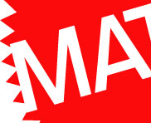
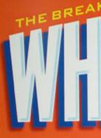
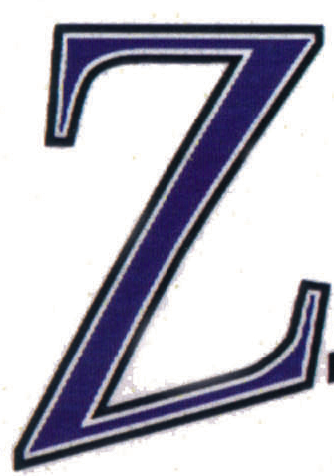
Trademark “Pieces”

Slide 37
Key to Logo Images
Pez, Google, Mattel, Coca Cola
Planters, UAH, NFL, Wheaties, Vanderbilt
McDonald’s, Zaxbys, Rolling Stones, MasterCard, Walmart

Slide 39
Key to Alphabet Images
A = All detergent B = Bubblicious gum
C = Campbell’s soup D = Dawn detergent
E = Eggo waffles F = Frito Lay
G = Gatorade drink H = Hebrew National franks
I = Icee drink J = Jello
K = Kool Aid L = Lysol cleaner
M = M&M candy (peanut) N = Nilla wafers
O = Oreo cookies P = Pez candies
Q = Q-tips ear swabs R = Reese’s cup candies
S = Starburst candies T = Tide detergent
U = Uncle Ben’s rice V = V-8 drink
W = Wisk cleaner X = X-14 cleaner
Y = York Peppermint Patty Z = Zest soap

Slide 40
Non-Competition Agreements
Considerations for enforcement:
Employee must be employed at time of signing.
No good against “professionals.”
No good against independent contractors.
No-hire/non-solicitation is limited.
Must preserve a “protectable interest.”

Slide 41
IP LAW TRIVIA
When were IP
rights first protected?
In 1783, people persuaded the Continental Congress "that nothing is more properly a man's own than the fruit of his study, and that the protection and security of literary property would greatly tend to encourage genius and to promote useful discoveries." Then the first copyright law in the us was written.
@LOFTINHOLT

Slide 42
IP LAW TRIVIA
What was the
first patent in the US?
It was issued on July 31, 1790 to Samuel Hopkins for a process of making potash, an ingredient used in fertilizer. President George Washington signed it.
@LOFTINHOLT

Slide 43
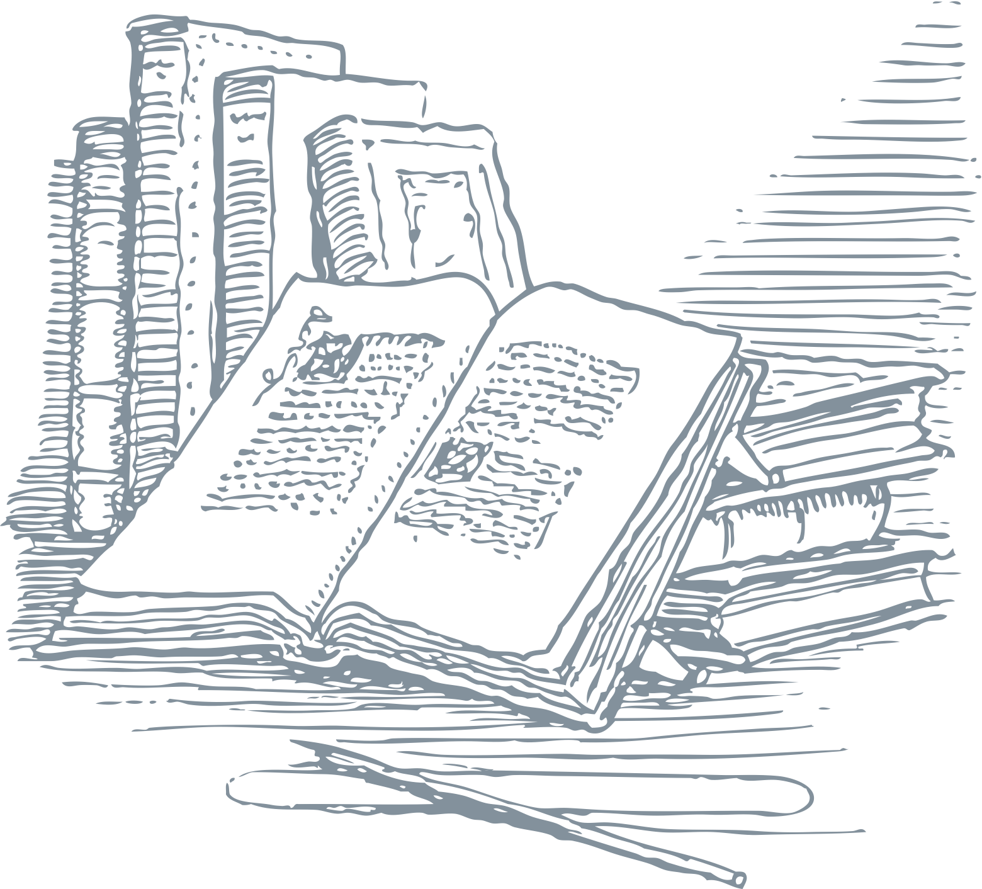
IP LAW TRIVIA
What was the
first copyright in the US?
It was for The Philadelphia Spelling Book arranged by John Barry
dated June 9, 1790.
@LOFTINHOLT

Slide 44
IP LAW TRIVIA
What is the oldest
trademark in the US still in use?
It is for a picture of the Biblical figure Samson wrestling a lion. It was registered by J.P. Tolman Company, which makes ropes, on May 27, 1884.
@LOFTINHOLT

Slide 45
Patents
U.S. is “First to File” – so FILE
Establish a culture of IP awareness
Trademarks
Consider having a SEARCH performed before filing application
If “Intend” to use – file an “Intent To Use” application (get your place in line)
Design mark – if change logo (a lot or a little)- REFILE
®, TM, SM – Use the correct notification symbol
Is the mark used in foreign markets? Consider foreign filings
Copyrights – File registration early, i.e., before infringement for enforcement benefits
Joint Authorship issues?
Trade Secrets – Keep it SECRET
Use ALL available forms of protection (incl. contracts)
Notes:
If you don’t remember anything else, remember these highlights… For everything else, remember my name/number/email address

Slide 46
CONTACT US
200 Clinton Ave W, Suite 405
Huntsville, Alabama 35801
(256) 929 - 7994
david@loftinholt.com
Protect
your property.
Contact us to
find out how.

