Slide 1
Law Practice Management, Ethics, & Zoom
Last Chance Seminar
December 3, 2021

Slide 2
Autumn A. Caudell
Assistant Ethics Counsel
Director of Practice Management Assistance Program
Native of Tuscaloosa, Alabama
University of Alabama (2010)
Jones School of Law (2013)
Private Practice (2013-2019)

Slide 3
Office of General Counsel
General Counsel
Roman Shaul
Disciplinary Division
Jeremy McIntire
Mark Moody
Ethics Division
Tripp Vickers
Autumn Caudell
Numerous invaluable staff

Slide 4
What do we do?
Disciplinary Counsel
Investigate & Prosecute
Disability & Reinstatement
Character & Fitness Appeals
CLE Compliance
CLE Presentations
“Any other duty or responsibility conferred … by the Executive Committee of the Board of Bar Commissioners of the Alabama State Bar.”

Slide 5
What do we do?
Ethics Counsel
Informal Ethics Opinion
Represent the Bar in Litigation
Support the Executive Director & Bar Departments
CLE Presentations
“Any other duty or responsibility conferred … by the Executive Committee of the Board of Bar Commissioners of the Alabama State Bar.”

Slide 6
What can I help you with?
Give licensed Alabama attorneys a confidential opinion regarding the ethical propriety of their prospective conduct based upon a verifiable set of facts.

Slide 7
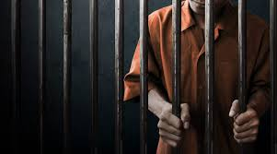
What I cannot do

Slide 8
Informal Ethics Opinion
Call: 334-269-1515
Email: ethics@alabar.org
Write: Alabama State Bar
Center for Professional Responsibilities
Post Office Box 671
Montgomery, AL 36104

Slide 9
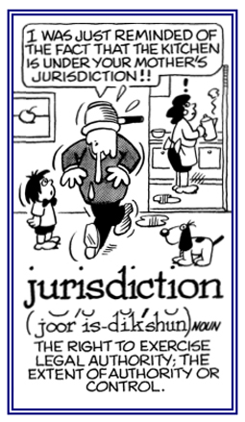
Jurisdiction
Notes:
Alabama Rules of Disciplinary Procedure 1(a)(1): The Alabama State Bar has jurisdiction over lawyers admitted to practice law in this sate, including district attorneys, assistant district attorneys, United States attorneys, assistant U S Attorneys, the attorney general, assistant AGs, and lawyers specially admitted by any court in this state for a particular proceeding.

Slide 10
Disciplinary Stats
Complaints Received 1317
Complaints Screened Out 969
Formal Investigation Files Opened 305
Private Reprimands 19 Public Reprimands 14
Suspensions 14
Disbarments 5 Consent to Disbarment 9 Transfer to Disability Inactive 6
Probation(with suspensions abated) 1
Formal Opinions Issued 1
Informal Opinions Issued 3,300

Slide 11
Perception
Notes:
What do you see? Duck or Rabbit? Webster defines Perception as “a way of regarding, understanding, or interpreting something. A mental impression. Your perceptions are predicated on your experiences.

Slide 12
How are lawyers perceived?

Slide 13
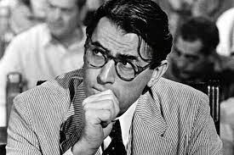
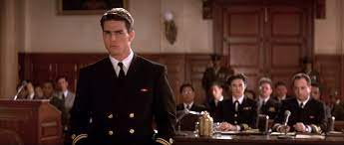
How we see ourselves
Notes:
Defenders of Justice. Fighting the Good fight!

Slide 14
Are you ethical?
Ranking the Honesty and Ethical Standards of each Profession:
Nurses 89%
Medical Doctors 77%
Pharmacist 71%
Police Officers 52%
Clergy 39%
Lawyers 21%
**2020 Gallup Poll
Notes:
Politicians, used car salesmen, and telemarketers are about the only people below us and we all know what people think about them

Slide 15
Changing Perceptions?
Notes:
How can we bridge the gap? Practicing law ethically

Slide 16
Competence
Notes:
Competence is the cornerstone of the legal profession and the attorney-client relationship. Ala. R. Prof. C., Rule 1.1. A lawyer shall provide competent representation to a client. Competent representation requires the legal knowledge, skill, thoroughness, and preparation reasonably necessary for the representation. A lawyer and client may agree, pursuant to Rule 1.2(c), to limit the scope of the representation with respect to a matter. In such circumstances, competence means the knowledge, skill, thoroughness, and preparation reasonably necessary for such limited representation.

Slide 17
Rule 1.1 - Competence
A lawyer shall provide competent representation to a client. Competent representation requires the legal knowledge, skill, thoroughness, and preparation reasonably necessary for the representation. A lawyer and client may agree, pursuant to Rule 1.2(c), to limit the scope of the representation with respect to a matter. In such circumstances, competence means the knowledge, skill, thoroughness, and preparation reasonably necessary for such limited representation.
Notes:
Competence is the cornerstone of the legal profession and the attorney-client relationship. Ala. R. Prof. C., Rule 1.1.

Slide 18
Staying Informed
Notes:
To maintain the requisite knowledge and skill, a lawyer should keep abreast of changes in the law and its practice, including the benefits and risks associated with relevant technology, engage in continuing study and education and comply with all continuing legal education requirements to which the lawyer is subject.

Slide 19
Legal Knowledge: Fastcase
Notes:
Fastcase is a free legal research tool offered to all of our members. Stay up to date with new statutes and case law! Fastcase recently merged with Casemaker and will be integrating new secondary sources as well!

Slide 20
The Scoop

Slide 21
Zoom and Notarization

Slide 22
Virtual Witnessing?

Slide 23
Notes:
Can’t teach an old dog new tricks

Slide 24
Video Conferencing

Slide 25
Equipment
Notes:
If you will routinely use Zoom, then you should invest in specialized equipment, including the Pro Plan and proper internet that has enough speed to support a video conference. Shout out to Morris Lilienthal from Huntsville for the equipment recommendations

Slide 26
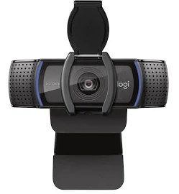
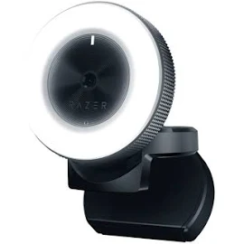
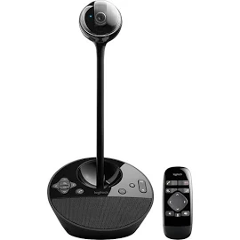
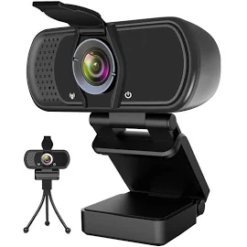
Web Camera
Notes:
Although most laptops come equipped with a camera, those cameras are not intended to be used for video conferences. You can get a camera that isn’t very expensive but will provide a great quality experience.

Slide 27
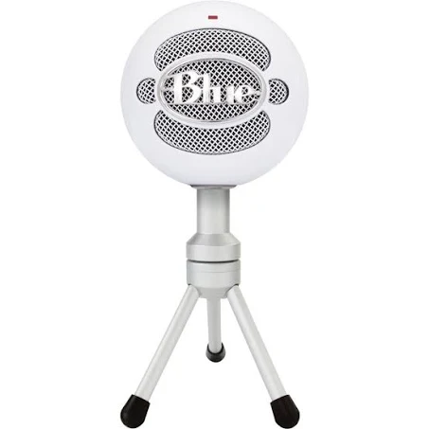
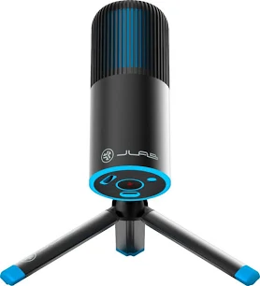
Microphone
Notes:
A microphone in my opinion is a must. If you can only purchase one piece of equipment, you should get a microphone. This is particularly important for depositions or hearings where you need a clean record.

Slide 28
Ring Light
Notes:
I think the difference is obvious from the above picture. If you will routinely use Zoom for work, then you should invest in a ring light. They are relatively inexpensive for the amount of light and clarity it provides. If you skip the ring light be sure you have proper lighting in your “Zoom Room”

Slide 29
Internet
Notes:
Make sure you have a stable internet connection and check you speed. You should routinely check speed, have provider run diagnostic if not an acceptable speed and to refresh your router and motom. You can download Speedtest app to test your Wifi speed.

Slide 30
Set up your meeting space
Notes:
The first step to ensure you have a smooth Zoom meeting or hearing is to set up your meeting space. If you will be working remotely, make sure you have a dedicated work space.

Slide 31
Set up your meeting space
Check the lighting
Adjust your camera position
Clear the clutter and prepare the area
Keep distractions to a minimum
Check your connection
Check your filters and desktop if you intend to share your screen

Slide 32
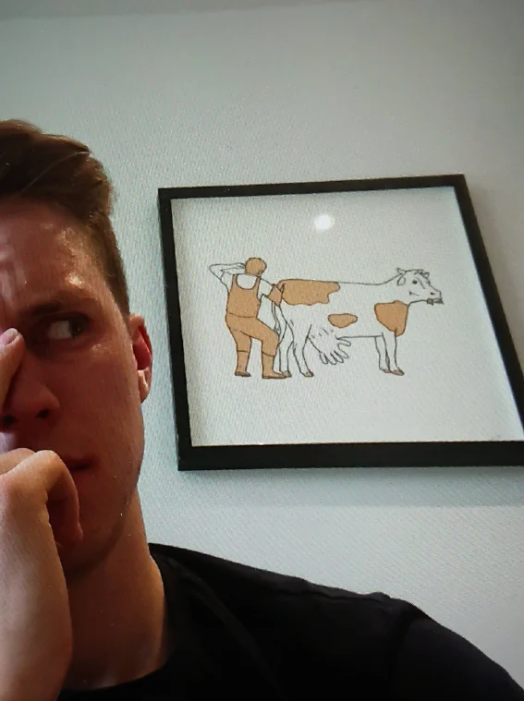
Background fails
Notes:
The first step to ensure you have a smooth Zoom meeting or hearing is to set up your meeting space. If you will be working remotely, make sure you have a dedicated work space. And have a vanilla area free of clutter and inappropriate art

Slide 33
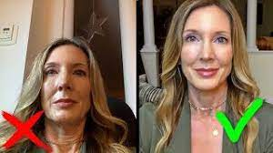
Check your angle
Notes:
Make sure to check your camera an angle brio to the meeting. Avoiding unflattering positions

Slide 34
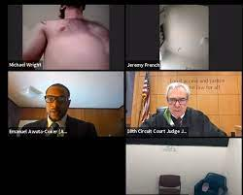
Check your angle
Notes:
Make sure to check your camera an angle brio to the meeting. Avoiding unflattering positions

Slide 35
Improper Lighting
Notes:
If you decide a ring light is not for you, make sure to test the lighting prior to your meeting

Slide 36
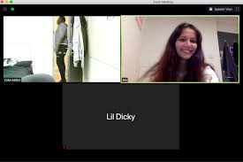
Name
Notes:
The first step to ensure you have a smooth Zoom meeting or hearing is to set up your meeting space. If you will be working remotely, make sure you have a dedicated work space.
Trappgod19 story

Slide 37
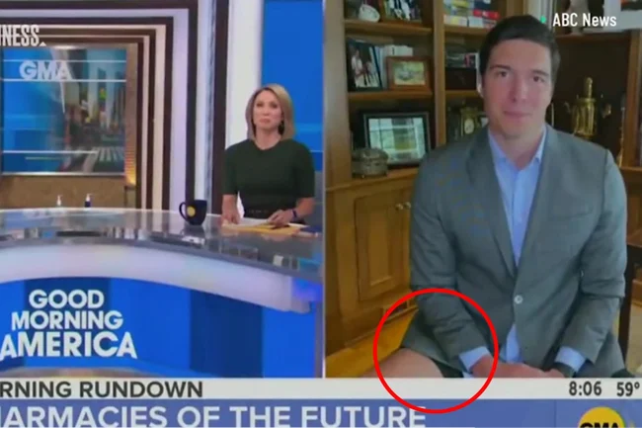
Dressing for success
Notes:
Although Zoom feels less formal it is still a professional setting and you should dress as such. If you decide to only be Zoom ready from the waist up, lets make sure the camera is position to only show your zoom ready attire

Slide 38
Judge, I am not a cat

Slide 39
Preparing your clients and witnesses for Zoom
Notes:
Zoom is the new normal. We must know how to use Zoom, ensuring mic is off when needed, preparing witnesses, maintaining confidentiality, properly introducing evidence, and dressing appropriately for the hearings.

Slide 40
Zoom and Depositions

Slide 41
To Zoom or Not to Zoom
There are times where you may not want to use Zoom
Timing
Can it wait?
Is moving forward important to the case
Type of Witness
Sometimes you might lose the intensity of the moment
When you need to show physical evidence
If you have a document-intensive case
Equipment
Does the client have access to stable internet, laptop, and a safe space to provide testimony
Zoom Room

Slide 42
Witness Prep
Notes:
-Confirm that your witness has reliable, stable internet access
-Check internet speed
-Help make sure they have the right set up on their computer
-Always do a test run
-Dress for the occasion
-Remove distractions
-Speak slowly
-Practice with client prior to deposition
-Trial run to ensure all equipment is properly working
-Consider if you will need extra time to deal with tech issues
-Do not forget to notice a video deposition

Slide 43
Exhibits
Paper Copies
Pro: Easier for some witnesses to use
Con: gives away the advantage of surprise
Pre-deposition electronic delivery
Pro: You can guarantee delivery by a certain date
Con: gives away the element of surprise
Electronic delivery during Deposition
Pro: You take advantage of the surprise
Con: If the witness is friendly, there may be advantages of providing an early copy of depositions

Slide 44
Exhibits
Consider hiring a Court Reporting company technician to help with exhibits
Have a partner or assistant available to help with exhibits during depositions

Slide 45
Exhibits
Notes:
-Label all exhibits
-close all other windows
-make it easy to get to exhibits quickly
-use the chat bot to attach PDFs in the file section
-have an assistant to run the exhibits

Slide 46
Exhibits

Slide 47
Stipulations
Agree that deposition will be taken remotely, including administering the oath remotely
Identify the platform (i.e. zoom)
Identify the court reporting company and any other third party vendors providing tech support
Create a procedure for making objections
Lay out who will be recorded during the deposition
Get an agreement that opposing counsel will not coach witness during the deposition
Dictate how exhibits will be provided
Protective order considerations

Slide 48
Controlling the Witness
Ask the deponent foundational questions to eliminate challenges to the testimony later
Are you in an environment suitable for giving testimony. Please notify me if that changes
Can you hear me clearly? If you cannot, please let me know
If you experience any technical issues, please let me know
Are you alone? Can you show me the room? Please notify me if anyone enters the room
Please turn off all cell phones, apple watches, iPads or other device that will not be used in this deposition
Do you have any notes in front of you?
Advise deponent to look at the camera when answering questions

Slide 49
Notes:
Do not forget to notice a video deposition
Disable private chat feature
Practice before the deposition
Test all equipment the day of the deposition
If the lawyer is present with the client, ensure the lawyer can be seen as well
Speak slowly

Slide 50
Zoom Hearings

Slide 51
Witness Prep
Notes:
-Confirm that your witness has reliable, stable internet access
-Check internet speed
-Help make sure they have the right set up on their computer
-Always do a test run
-Dress for the occasion
-Remove distractions
-Speak slowly
-Practice with client prior to deposition
-Trial run to ensure all equipment is properly working
-Consider if you will need extra time to deal with tech issues
-Do not forget to notice a video deposition

Slide 52
Discuss the role of the witness and effective demeanor
Inviting the witness to provide truthful testimony favorable to the client
Discuss the witness’s recollection and probable testimony
Instructing the witness how to testify
Discussing the applicability of law to the events at issue
Reviewing the factual context into which the witness’s observation or opinions will fit

Slide 53
Reviewing documents or other physical evidence that may be introduced
Preparing the witness for probable lines of hostile examination that the witness should be prepared
Rehearsing testimony
Suggest choice of words that might be used to make the witness’ meaning clearer
Suggest subject matter to focus on in responding to questions
Advising witness to only answer the question asked and not to provide more information than is asked of the witness

Slide 54
Instruct the witness what to say
Advise the witness to lie or intentionally mislead
Cannot mislead or misstate other evidence or testimony to encourage witness to provide false testimony
Do not suggest a change of words that alters in anyway the witness’s testimony

Slide 55
Investigating

Slide 56
Rule 4.1 Truthfulness in Statements to Others
In the course of representing a client a lawyer shall not knowingly: (a) Make a false statement of material fact or law to a third person; or (b) Fail to disclose a material fact to a third person when disclosure is necessary to avoid assisting a criminal or fraudulent act by a client, unless disclosure is prohibited by Rule 1.6.

Slide 57
Catfishing
Notes:
Lawyers and their agent may use their real names and profiles to send friend request to obtain information from an unrepresented person’s social media site. Lawyers and their agents are not required to disclose the reasons for making such requests but may NOT attempt to do so under false pretenses or names. Do NOT create a fake Facebook (or other social media account) to obtain information on adverse witnesses or party. If the person is represented, you cannot friend request without the permission of the party’s attorney. See 4.1 and 8.4, Ala. R. Prof. C.

Slide 58
Zoom Client Meetings

Slide 59
Keeping clients informed

Slide 60
Rule 1.4 - Communication
(a) A lawyer shall keep a client reasonably informed about the status of a matter and promptly comply with reasonable requests for information.
(b) A lawyer shall explain a matter to the extent reasonably necessary to permit the client to make informed decisions regarding the representation.

Slide 61
What you cannot do

Slide 62
Does your client understand?
Explain the process, players, facts, and terms to your client so they are informed and able to make competent decision regarding their case.
Do not assume your client understands even basic terms.
Ask follow up questions to gauge your client’s understanding.
Ensure your client has a basic understanding of how to use Zoom (practice with your client)

Slide 63
Confidentiality

Slide 64
Rule 1.6 Confidentiality of Information
(a) A lawyer shall not reveal information relating to the representation of a client unless the client consents after consultation, except for disclosures that are impliedly authorized in order to carry out the representation, and except as stated in paragraph (b).

Slide 65
Cyber Security
Notes:
An attorney’s duties of confidentiality and competence require the attorney to take appropriate steps to ensure that his or her use of technology in conjunction with a client’s representation does not subject confidential client information to an undue risk of unauthorized disclosure. Because of the evolving nature of technology and differences in security features that are available, the attorney must ensure the steps are sufficient for each form of technology being used and must continue to monitor the efficacy of such steps.
The same ethics opinion provides that before using technology in the course of representing a client, an attorney must take appropriate steps to evaluate: (1) the level of security attendant to the use of that technology, including whether reasonable precautions may be taken when using the technology to increase the level of security; (2) the legal ramifications arising from a third party who intercepts, accesses, or exceeds authorized use of the electronic information; (3) the degree of sensitivity of the information; (4) the possible impact on the client of an inadvertent disclosure of privileged or confidential information or work product; (5) the urgency of the situation; and (6) the client’s instructions and circumstances, such as access by others to the client’s devices and communications. Failure to learn the technology and take reasonable precautions could lead to an unintended disclosure of confidential client communications and information.

Slide 66
Zoom Security
Notes:
Updates are important because they usually have security updates that are meant to protect your account and information
Check your configuration: disable screen share with the exception of the host, have a two factor authentication, password protect your zoom, verify participants in the room to ensure confidential information is not leaked, control when the meeting starts and enable the host to admit participants to prevent unwanted participants.

Slide 67
Rule 1.15 Safekeeping Property
(a) A lawyer shall hold the property of clients or third persons that is in the lawyer's possession in connection with a representation separate from the lawyer's own property. Funds shall be kept in a separate account maintained in the state where the lawyer's office is situated, or elsewhere with the consent of the client or third person. No funds of a lawyer shall be deposited in such a trust account, except (1) unearned attorney fees that are being held until earned, and (2) funds sufficient to pay bank service charges on that account or to obtain a waiver thereof. Any funds while in the lawyer's trust account that the lawyer is entitled to receive as a fee, reimbursement, or costs shall not be used by the lawyer for any personal or business expenses until such funds are removed from the trust account.

Slide 68
Do you need a Trust Account?
Rule 1.15(a)
Client and 3rd party funds shall be held separate from the lawyer’s own property.
Funds shall be kept in a separate account… in the state where the lawyer’s office is… (unless client consents otherwise.)
Rule 1.15(j) – A lawyer shall maintain a separate account for client and 3rd party funds.
Limited exceptions.

Slide 69
Limited Exceptions
Exceptions:
Not engaged in active practice. See Ala. Code §34-3-6
Never hold funds for clients or 3rd parties
Judges; attorney generals; public defenders; U.S. Attorneys; District Attorneys
On duty with armed services or employed by local, state or federal government and not practicing
Corporate counsel or law professor and not practicing

Slide 70
Rule 1.15 only applies to money

Slide 71
Not just money

Slide 72
File Retention
Formal Opinion 2010-02: “Rule 1.6, Ala. R. Prof. C., embodies one of the most fundamental principles of our profession and requires that with few exceptions, a “lawyer shall not reveal information in relation to representation of a client.” The duty to maintain confidentiality includes a duty to segregate, protect and safeguard a client's file and the information it contains. The obligation to maintain a client’s file contemporaneously organized in an orderly filing and indexing system is inherent in the duty of confidentiality and explicit in Rule 1.15.The failure to do so is a breach of 1.15 and may also rise to the level of a breach of 1.6. The principals of confidentiality, loyalty and fidelity are so fundamental to the practice of law that these rules must be enforced to eliminate even the risk of breach of these principles.”

Slide 73
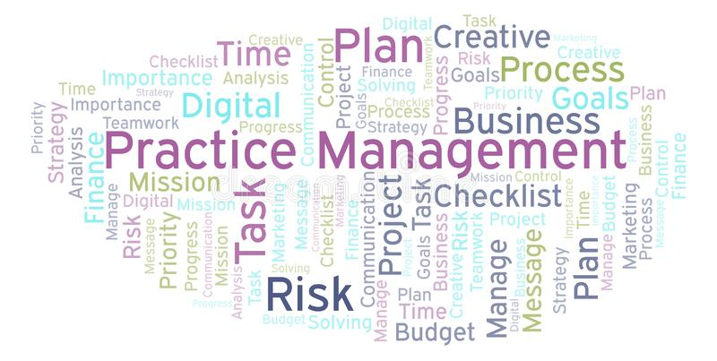
Practice Management Assistance Program
Notes:
Law Practice Management Month: Promos, Giveaways, and Free CLEs

Slide 74
PMAP
The Practice Management Assistance Program was established to help lawyers increase the quality of legal services and improve client relations by providing practical systems to establish quick, consistent, and easy-to-use processes for exchanging information with their clients.

Slide 75
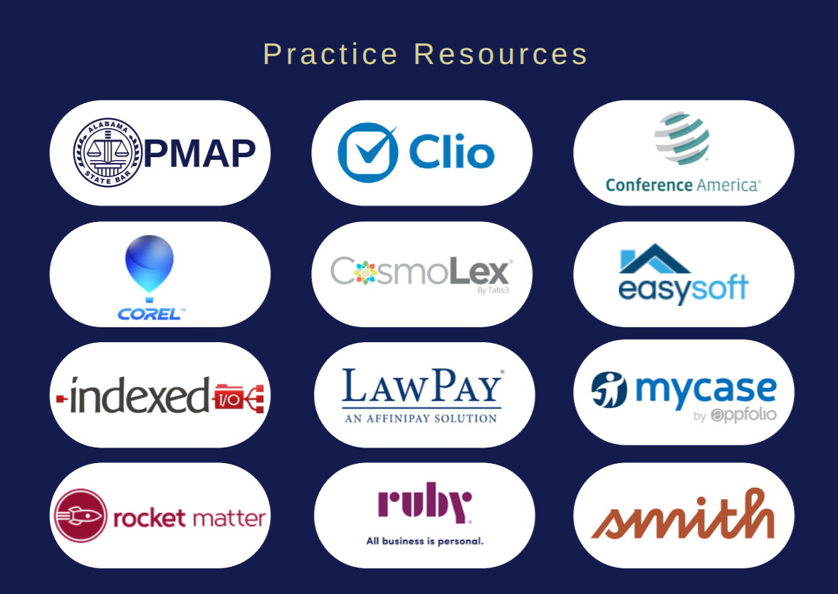
Member Benefits

Slide 76
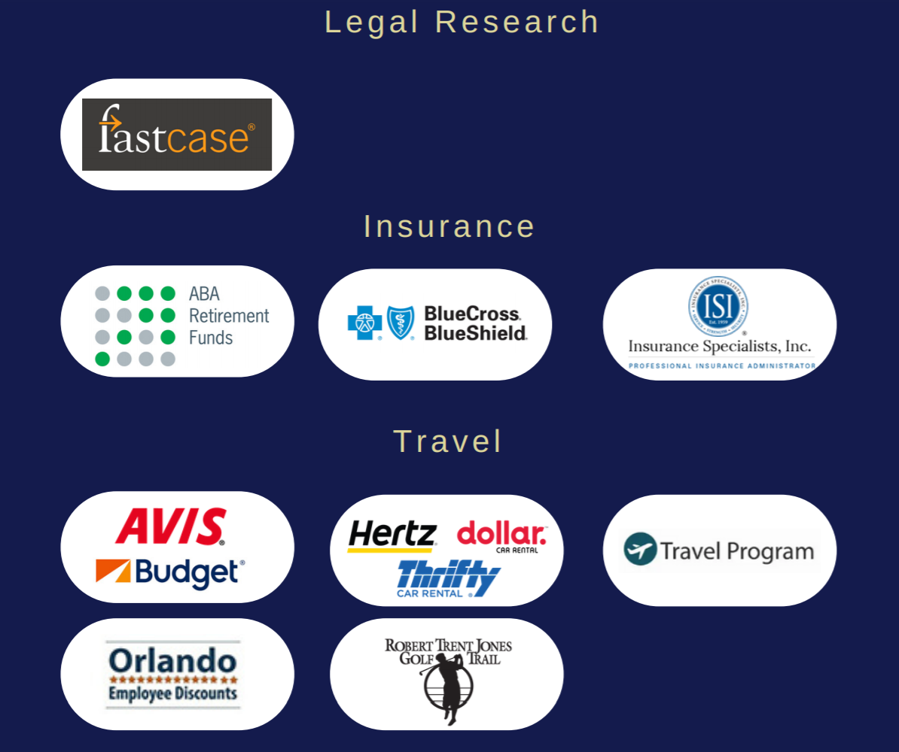
Member Benefits

Slide 77
Member Benefits

Slide 78
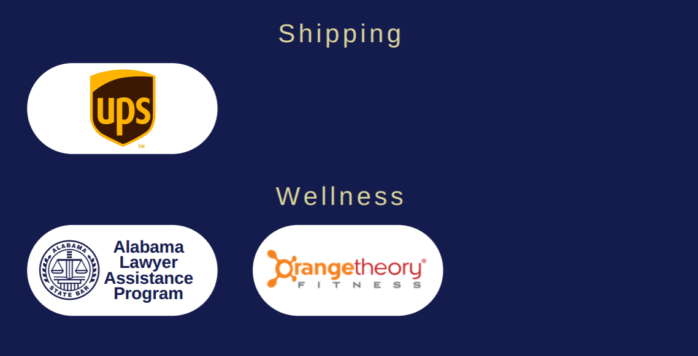
Member Benefits

Slide 79
Lawyers and Mental Health

Slide 80
Mental Health Statistics
In the general population, 1 in 100 people are addicted to drugs or alcohol
2 in 100 attorneys are addicted to drugs or alcohol
Lawyers are 3.6 times more likely to suffer from depression than non-lawyers
Lawyers have the 7th highest suicide rate among any profession

Slide 81
Lawyer Assistance Program
Jeremy Rakes – ALAP Director
Call: 334-517-2238
Email: jeremy.rakes@alabar.org
24 Hour Helpline: 334-224-6920

Slide 82
Questions?

