Slide 1
From Keeping Time to Doing Time: How Lawyers Run Afoul of the Alabama Securities Act Walking the fine line in the role of an attorney
Joseph Borg
Alabama Securities Commission

Slide 2
Why lawyers?
1. In fraud cases, the currency is TRUST
2. Fraudsters need credibility
3. Attorneys offer credibility
4. The role of an attorney is an evolving one
5. The use of attorneys to promote fraud

Slide 3
The various roles of the attorney in securities cases
Advise and render opinions in compliance matters
Prepare and file registration statements with state and federal authorities
Prepare offering documents in accordance with respective securities laws
Determine company structure and type of securities to be offered
Evaluate investment opportunities, especially those of issuers involving privately held companies
Serve as escrow agent in securities transactions***

Slide 4
Key issues
Is the individual or company issuing “securities.”
If a security is involved, is it exempt from registration?
If exempt, which exemption? Rules 504, 506, Reg. A or crowdfunding
Which facts are “material” facts and require disclosure
Initial Coin Offerings (ICO’s)
Sale of securities; operation of stock exchange; sale of an unregistered mutual fund; sale, advertising and promotion of commodities…

Slide 5
The Alabama securities act
Ala. Code § 8-6-1 et seq.
8-6-3 Registration and bonds of dealers and salesmen
8-6-4 Registration of Securities
8-6-10 Exempt Securities
8-6-11 Exempt Transactions
8-6-17 Prohibited Acts regarding the offer, sale, or purchase of securities
8-6-18 Criminal Penalties
8-6-19 Civil Liabilities of sellers, agents, etc., and remedies of purchasers

Slide 6
The lawyer defendants
The Compliance Lawyer
The Document Preparer
The Paymaster

Slide 7
The Compliance lawyer….or the co-conspirator??
Lawyers as gatekeepers assisting promoters in their offerings. SEC v. National Student Marketing Corp.- gatekeeper liability
SEC charged law firm for aiding and abetting a client fraud when they failed to take certain actions in connection with a merger.
Ensure good behavior by pursuing those who control “access” to capital markets.
Lawyers are not securitizing the offerings and allowing clients to proceed without compliance with securities laws.
Not making mandated disclosures for clients- ex: U4 filings
Insufficient advice regarding disclosures.

Slide 8
The document preparer
Attorney prepares subscription or security agreements containing fraudulent information- either deliberately or due to a lack of due diligence.
Attorney becomes involved in the effectuation of securities transactions.
1. “Issuer”- Every person who proposes to issue, has issued, or shall issue any security. Any person who acts for a compensation or consideration as a promoter for or on behalf of a corporation, trust, unincorporated association, partnership.
2. “Dealer”- Any person engaged in the business of effecting transactions in securities for the account of others or for his own account.
2. “Agent” – Any individual other than a dealer who represents a dealer or issuer in effecting or attempting to effects sales of securities.
Case study: Integrity capital LLC

Slide 11
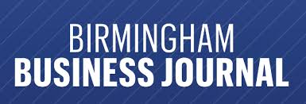

Slide 12
Who is the client? Considerations of the Attorney Client relationship and Privilege
The historical context of Attorney-Client Privilege
Prerequisite relationship at the time of communication
Intent to create a confidential communication
Attorney-Client privilege/limits of deliberative privilege
Privilege in the corporate setting; Upjohn Co. v. U.S.--subject matter test
Attorney-Client privilege in the governmental setting

Slide 13
The Paymaster
The attorney allows the use of his name and trust account to lend legitimacy to the transaction.
The attorney received investor funds into trust account, takes fee, and/or transfers funds out at the direction of the defendant.
Case Studies:
Terry Earl Hester
KVH Capital Investment Partners
John Doe (case under investigation)- held funds in trust account and received fee
John Doe II (Maddrey)- same facts as above
Synergy Finance Group- Samuel Williams

Slide 14
Samuel Williams Jr., 50, was processed into jail Tuesday. Arrested March 22 in Atlanta by the Fulton County Sheriff’s Department, he was released March 25 on $75,000 bail and given until April 20 to surrender to Baldwin County authorities, according to the Alabama Securities Commission.
By Kim Lanier, Press-Register on April 25, 2011 at 10:01 AM

Slide 15
Video 1

Slide 16
Sam Williams video

Slide 17
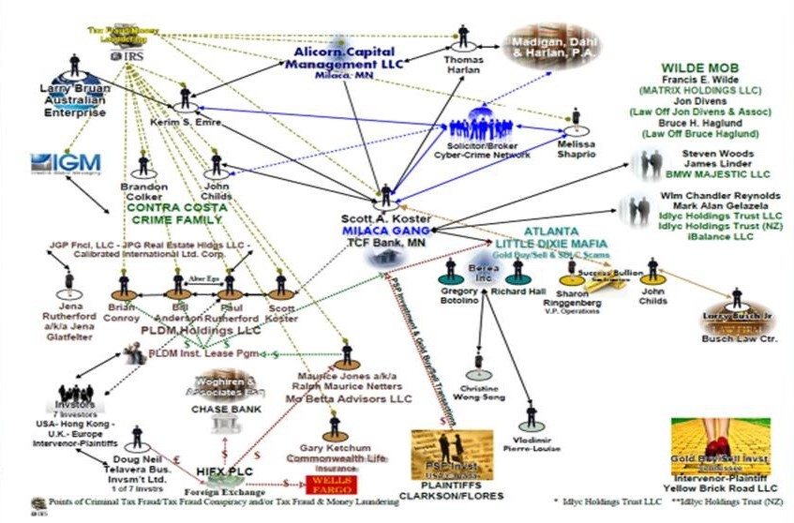

Slide 18
ATTORNEY SUSPECTS/DEFENDANTS
KVH Capital Investment Partners, Inc.
Total of Approximately $42 million of investor funds passed through the attorney trust/escrow accounts.
Attorney Hendrickx Toussaint (GA) (Guilty Plea)
Attorney Larry Busch (AZ) (Guilty Plea)
Attorney Robert Levine (FL) (Guilty Plea)
Attorney from (CA) (Under investigation by federal authorities)
Attorney from (GA) (Suspect)
Attorney Bruce Haglund (CA) (Prosecuted by federal authorities)
Attorney from (OH) (Suspect)

Slide 19
ATTORNEY SUSPECTS/DEFENDANTS
Jack Glover, a Trussville, AL attorney (Guilty Plea)
Total of$197,500 involving sale of promissory notes and passing money from trust account to broker in Texas who spent funds for personal use.
Current investigation involving $120,000 investor funds divided among the brokers and spent for non-investment purposes.
Attorney from (NY) (Suspect currently under investigation)
Current investigation involving $350,000. Paymaster received investor funds into his trust account.
Attorney from (FL) (Suspect currently under investigation)

Slide 20
ATTORNEY SUSPECTS/DEFENDANTS
Current investigation involving Alabama brokers who solicited at least $1,025,000 from investors with a promised return of millions of dollars within a few days.
Attorney from (AZ) (Suspect under investigation)
Attorney from (CA) (Suspect under investigation)
Attorney from (NY) (Suspect under investigation)

Slide 21
ATTORNEY SUSPECTS/DEFENDANTSATT
A Birmingham Attorney (under investigation)
Estimated funds involved are $15-20 million from over 120 investors during the last 12 years through a Nigerian bank scheme..
Entertainment venture
Approximately $1.5 million involved. Sold interest in a movie production to five Alabama investors through an unregistered Alabama agent.
Attorney (Suspect) from CA

Slide 22
ATTORNEY SUSPECTS/DEFENDANTS
Attorney (Person of Interest), New Jersey
Approximately $1.5 million a “Private Placement Funding Agreement” involving a church” depositing funds into an Attorney Trust Account.
Water Bottling Company venture
Involves approximately $1.4 million. The agreement was structured as a promissory note that transferred the assets and stock to another company.
Attorney (Suspects), New Jersey and New York Attorney

Slide 23
ATTORNEY SUSPECTS/DEFENDANTS
Alan Burdette Investments
Involves $3,046,717. Burdette was a former FBI Agent and a Birmingham based real estate attorney. Investors were approached by Burdette and solicited to invest funds with in real estate projects
Burdette was sentenced to 20 years split to serve 5 in a state penitentiary and ordered to pay over $4 million in restitution to victims.

Slide 24
A word about Deliberate Ignorance
US. V. Polichemi 219 F.3d 698: Attorney assisted D in prime bank scheme and accepted payments from the co-defendant’s sham company. D argued that the funds were payment of legal fees and that he was not aware of fraudulent scheme. Court disagreed stating Attorney D had a long-standing relationship with Co-Ds, was involved in Copol, was a signatory on the bank account where the illicit proceeds were deposited.
U.S. Graffia 120 F.3d 706, 713: Attorney represented multiple banks and financials indicated the banks had 4Bill in assets and only $43K in liabilities. Instruction on Deliberate Ignorance- court found not error to give jury Ostrich instruction when D claimed lack of guilty knowledge and there are facts in evidence that supported an inference of deliberate ignorance.

Slide 25
What’s the harm??
Victims of fraud come from all walks of life but in every case the victim depended on the lawyer to ensure the legitimacy of the transaction. Our actions deeply impact the lives of those we leave in the wake of our bad acts.

Slide 27
Victim 1 video

Slide 28
Victim 2 – business owner video

Slide 29
Stay straight and fly right!
Bad lawyering and bad lawyers affect us all. The credibility of the whole is at stake, even if only one is errant.
The ASC does not dispense legal advice but we offer guidance and…for a small fee, legal opinions!
Must be based on actual facts.
Contact the Alabama State Bar
Contact the Alabama Securities Commission: 334-242-2984

